Slide 1

REPORT BOOKING CAB WITHIN LPU
PROJECT NO. 09
As a project work for Course PYTHON PROGRAMMING (INT 213)
GROUP MEMBERS: HIMANSHU (12100881- A25)
SAIKAT NANDI (12104728 – A26)
AARYAN (12104731 – A27)
DATE OF SUBMISSION: November 22, 2022 SUBMITTED TO: AKSHARA RANA MAM

Slide 2
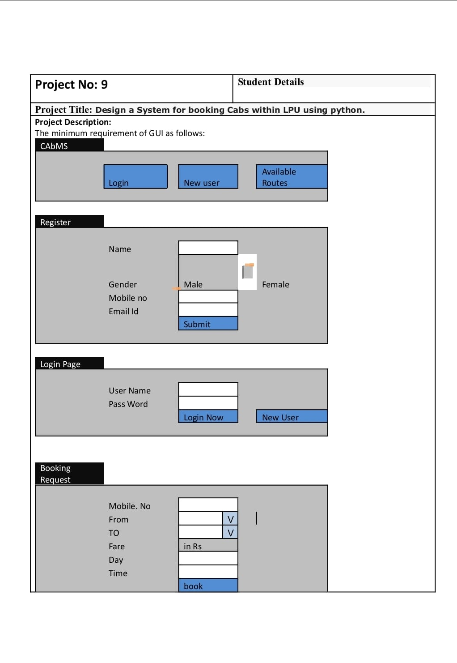

Slide 3
ACKNOWLEDGEMENT
We would want to convey my heartfelt gratitude to Akshara Rana mam for his invaluable advice and assistance in completing our project. He was there to assist us every step of the way, and his motivation is what enabled us to accomplish our task effectively. We would also like to thank all the other supporting personnel who assisted us by supplying the equipment that was essential and vital, without which we would not have been able to perform efficiently on this project. We would also want to thank the Lovely Professional University providing this opportunity to take this project and thank our friends for their support and encouragement as we worked on this project.

Slide 4
TABLE OF CONTENT
Abstract
Introduction
Objective
Team members
Library used
Algorithm used
Project screenshots
Appendix
Conclusion

Slide 5
ABSTRACT
Cab booking is a common kind of transportation provided by several transportation companies in each city. Most individuals rely on cab services for their everyday transportation requirements. The Online Cab Booking System is a web-based platform that enables your clients to book taxis and executive taxis from the convenience of their own home or workplace.
We had made the Booking Cab Within LPU Management System project which is used by Student/Faculty of LPU to book a cab within LPU. To book a cab within LPU Student/ Faculty must provide their mobile number, date, time, and route.

Slide 6
Introduction
Online Cab Booking System specializing in Hiring cabs to customers. It is an online system through which customers can view available route of cabs, register the cabs, book cabs. Cab booking service is a major transport service provided by the various transport operators in a particular city. Mostly peoples use cab service for their daily transportations need. The company must be a registered and fulfils all the requirements and security standards set by the transport department
We got the project on Booking Cab Within LPU. The aim of Booking Cab Within LPU project is to build a python- based Booking Cab Within LPU. Through this System Student/Faculty can easily travel in LPU which save their time to travel from one block to another block.

Slide 7
Objective
Now a days everyone is busy in their work many of the families do not have vehicle to travel so they book cab to travel from one place to other. They can take benefits by saving their precious time for traveling
The goal of an online cab booking system is to bring riders and drivers together on one platform. The online cab booking system makes traveling easier in this digital age by allowing you to move from one location to another with a single tap.
The System Specialty made for LPU faculty and students. By using this cab booking System they can save their time for travelling from one block to another block.

Slide 8
Team Members
Himanshu (12100881)
Research for project
Coding(joined)
GUI
Report
Saikat Nandi (12104728)
Research for project
GUI
Coding(joined)
Report
Aaryan (12104731)
Research for project
Coding(joined)
GUI
Report

Slide 9
Libraries used
Tkinter-
Tkinter is the standard GUI library for Python. Python when combined with Tkinter provides a fast and easy way to create GUI applications. Tkinter provides a powerful object-oriented interface to the Tk GUI toolkit.
Tkinter provides various controls, such as buttons, labels and text boxes used in a GUI application called as Widgets

Slide 10
ALGORITHM/ STEP
(Explain the different modules/functions used)
We have written the code in python language.
Our project is based on Booking cab within LPU
The functions of Booking Cab within LPU are:
New User: Click on New user to create the new account and enter the full valid details for creating an account.
Login: Enter the correct username and password to login.
Available routes: Click to check the routes for cab.
Booking: Enter details for booking the cab.
Quit: Function helps us to terminate the process.

Slide 11
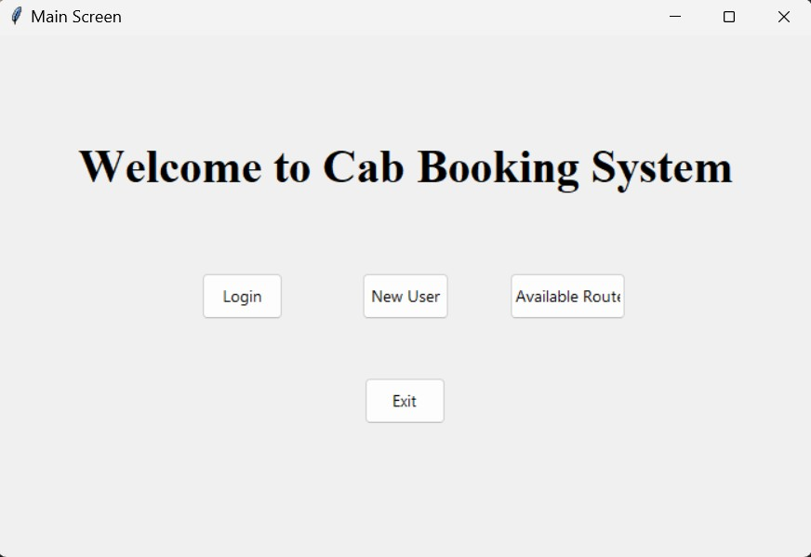
Project Screenshots
Main Screen:
There is one Login interface for existing customer. If there is any new user, then he/she can create a new account. Any user can check the route for cab.

Slide 12
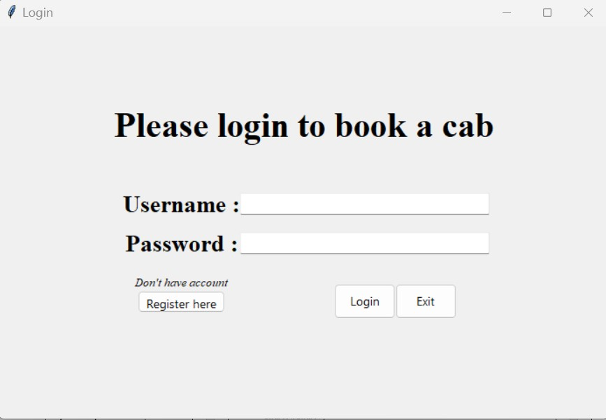
Next interface for existing customer:
In this user must provide their correct username and password to login into the system.

Slide 13
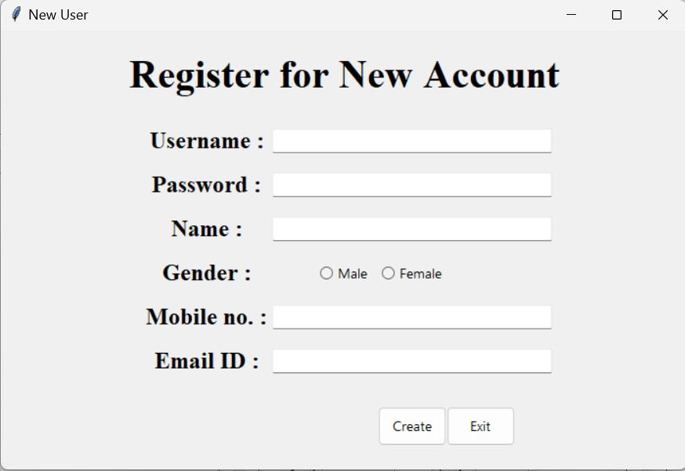
Next interface for new User:
In this user must provide all the credential to sign up into the system Username, Password, Name, Mobile no. etc

Slide 14
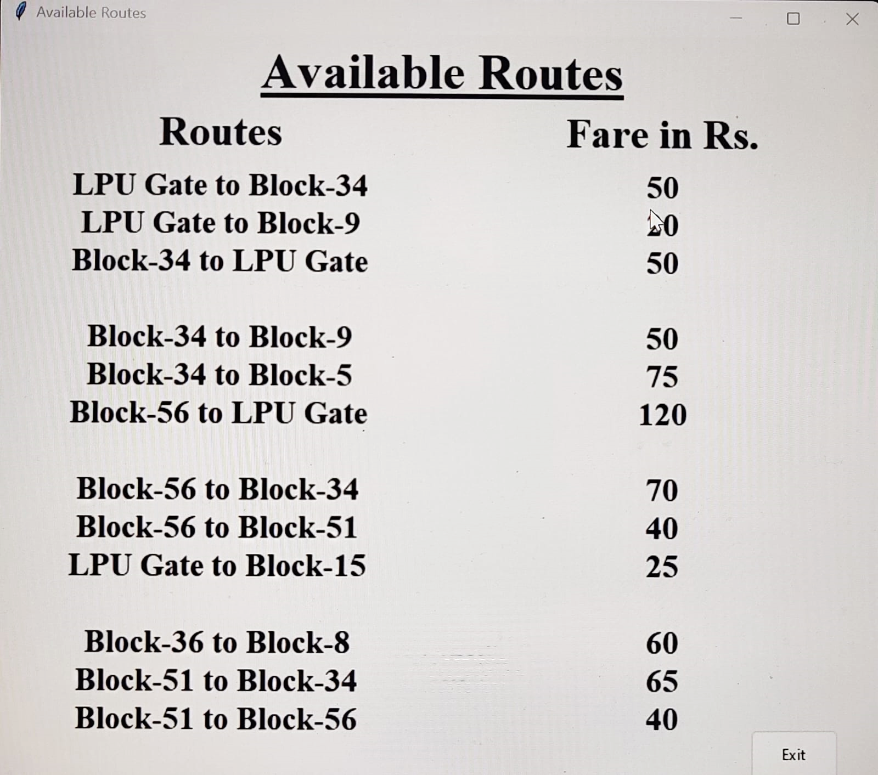
Routes Availability:

Slide 15
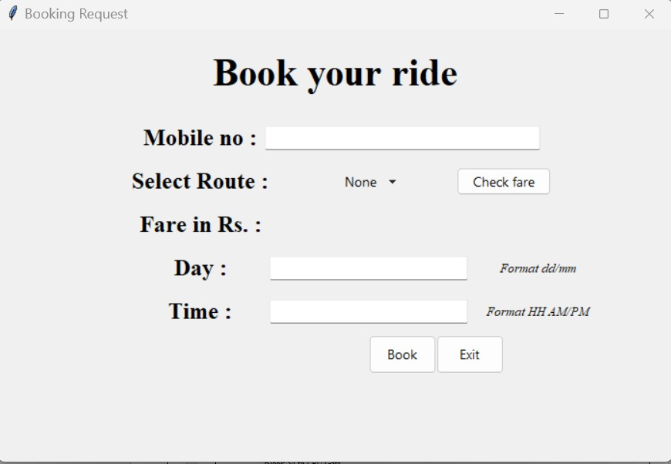
Booking window:
To book for cab user must provide his/her booking details e.g., mobile no, route, Day, and time. After Clicking on check fare the System will display the fare in Rs.

Slide 16
APPENDIX
from tkinter import *
from tkinter import messagebox from tkinter.ttk import *
user_names = ["Admin", ""] passwords = {"Admin": "admin"} options = [
"None",
"LPU Gate to Block-34", "LPU Gate to Block-12", "LPU Gate to Block-9", "Block-34 to LPU Gate", "Block-34 to Block-9", "Block-34 to Block-5", "Block-40 to LPU Gate", "Block-56 to Block-34", "Block-56 to Block-51", "Block-36 to Block-8", "Block-51 to Block-34", "Block-51 to Block-56"
]
rates = {
"LPU Gate to Block-34": "50", "LPU Gate to Block-15": "25", "LPU Gate to Block-9": "20", "Block-34 to LPU Gate": "50",
"Block-34 to Block-9": "50",
"Block-34 to Block-5": "75", "Block-56 to LPU Gate":"120",
"Block-56 to Block-34": "70",
"Block-56 to Block-51": "40",
"Block-36 to Block-8": "60",
"Block-51 to Block-34": "65",
"Block-51 to Block-56": "40",
}
root = Tk() root.geometry("700x450+300+100") root.title("Main Screen")

Slide 17
# for login
username1 = StringVar() password1 = StringVar()
# for new user gender_box = IntVar() username2 = StringVar() password2 = StringVar() name = StringVar() mobile_no = StringVar() Email_id = StringVar()
# for booking options_var = StringVar()
mobile_no_entry_text = StringVar() day_entry_text = StringVar() time_entry_text = StringVar()
# show rate def show_rate(child1):
a = str(options_var.get()) rate = rates[a]
lbl_fare_1 = Label(child1, text=rate, font='Times 18 bold') lbl_fare_1.place(relx=.6, rely=.45, anchor=CENTER)
# for booking def show_msg_booking():
mob = str(mobile_no_entry_text.get()) day = str(day_entry_text.get())
time = str(time_entry_text.get())
if mob != "" and day != "" and time != "": messagebox.showinfo("Booking Successful", "Booking Successful")
else:
messagebox.showerror("ERROR", "Mobile number or day or time is not filled")
# create account def create_new_user():
user_new = username2.get() pass_new = password2.get() gender = gender_box.get() name_new = name.get()

Slide 18
mob = mobile_no.get() email_new = Email_id.get()
if user_new != "" and pass_new != "" and (gender != 1 or gender != 2) and name_new != "" and mob != "" \
and email_new != "": user_names[1] = user_new
new_user_created = {user_new: pass_new} passwords.update(new_user_created) messagebox.showinfo("Successful", "New User Created successfully")
else:
messagebox.showerror("ERROR", "One or more field is empty")
def new_user():
root_child_1 = Toplevel(root)
root_child_1.title("New User") root_child_1.geometry("700x450+300+100")
lbl2 = Label(root_child_1, text="Register for New Account", font='Times 30 bold') lbl2.place(relx=.5, rely=.1, anchor=CENTER)
lbl_username = Label(root_child_1, text='Username :', font='Times 18 bold') lbl_username.place(relx=.3, rely=.25, anchor=CENTER)
username_entry = Entry(root_child_1, textvariable=username2, width=35) username_entry.place(relx=.6, rely=.25, anchor=CENTER)
lbl_password = Label(root_child_1, text='Password :', font='Times 18 bold') lbl_password.place(relx=.3, rely=.35, anchor=CENTER)
password_entry = Entry(root_child_1, show="*", textvariable=password2, width=35) password_entry.place(relx=.6, rely=.35, anchor=CENTER)
lbl_name = Label(root_child_1, text='Name :', font='Times 18 bold') lbl_name.place(relx=.3, rely=.45, anchor=CENTER)
name_entry = Entry(root_child_1, textvariable=name, width=35) name_entry.place(relx=.6, rely=.45, anchor=CENTER)
lbl_gender = Label(root_child_1, text='Gender :', font='Times 18 bold') lbl_gender.place(relx=.3, rely=.55, anchor=CENTER)
gender1 = Radiobutton(root_child_1, text='Male', variable=gender_box, value=1) gender1.place(relx=.5, rely=.55, anchor=CENTER)
gender2 = Radiobutton(root_child_1, text='Female', variable=gender_box, value=2) gender2.place(relx=.6, rely=.55, anchor=CENTER)

Slide 19
lbl_mobile = Label(root_child_1, text='Mobile no. :', font='Times 18 bold') lbl_mobile.place(relx=.3, rely=.65, anchor=CENTER)
mobile_no_entry = Entry(root_child_1, textvariable=mobile_no, width=35) mobile_no_entry.place(relx=.6, rely=.65, anchor=CENTER)
lbl_email = Label(root_child_1, text='Email ID :', font='Times 18 bold') lbl_email.place(relx=.3, rely=.75, anchor=CENTER)
email_entry = Entry(root_child_1, textvariable=Email_id, width=35) email_entry.place(relx=.6, rely=.75, anchor=CENTER)
submit_btn1 = Button(root_child_1, text='Create', command=lambda: [create_new_user()]) submit_btn1.place(relx=.6, rely=.9, anchor=CENTER, height=40, width=70)
exit_btn2 = Button(root_child_1, text='Exit', command=lambda: [root_child_1.destroy()]) exit_btn2.place(relx=.7, rely=.9, anchor=CENTER, height=40, width=70)
root_child_1.mainloop()
# login def login_button():
user1 = username1.get() user1 = str(user1)
pass1 = password1.get() pass1 = str(pass1)
a = "1"
for x in user_names: if user1 == x:
a = x
if a == user1 and passwords[a] == pass1: root_child_1 = Toplevel(root) root_child_1.title("Booking Request") root_child_1.geometry("700x450+300+100")
lbl5 = Label(root_child_1, text="Book your ride", font='Times 30 bold') lbl5.place(relx=.5, rely=.1, anchor=CENTER)
mobile_no_booking = Label(root_child_1, text='Mobile no :', font='Times 18 bold') mobile_no_booking.place(relx=.3, rely=.25, anchor=CENTER)
mobile_no_booking_entry = Entry(root_child_1, textvariable=mobile_no_entry_text, width=35) mobile_no_booking_entry.place(relx=.6, rely=.25, anchor=CENTER)
lbl_routes = Label(root_child_1, text='Select Route :', font='Times 18 bold')

Slide 20
lbl_routes.place(relx=.3, rely=.35, anchor=CENTER) routes = OptionMenu(root_child_1, options_var, *options) routes.place(relx=.55, rely=.35, anchor=CENTER)
rate_btn = Button(root_child_1, text="Check fare", command=lambda: [show_rate(root_child_1)]) rate_btn.place(relx=.75, rely=.35, anchor=CENTER)
fare = Label(root_child_1, text='Fare in Rs. :', font='Times 18 bold') fare.place(relx=.3, rely=.45, anchor=CENTER)
day = Label(root_child_1, text='Day :', font="Times 18 bold") day.place(relx=.3, rely=.55, anchor=CENTER)
day_entry = Entry(root_child_1, textvariable=day_entry_text, width=25) day_entry.place(relx=.55, rely=.55, anchor=CENTER)
day_format = Label(root_child_1, text='Format dd/mm', font="Times 10 italic") day_format.place(relx=.8, rely=.55, anchor=CENTER)
time = Label(root_child_1, text='Time :', font="Times 18 bold") time.place(relx=.3, rely=.65, anchor=CENTER)
time_entry = Entry(root_child_1, textvariable=time_entry_text, width=25) time_entry.place(relx=.55, rely=.65, anchor=CENTER)
time_format = Label(root_child_1, text='Format HH AM/PM', font="Times 10 italic") time_format.place(relx=.8, rely=.65, anchor=CENTER)
submit_btn1 = Button(root_child_1, text='Book', command=lambda: [show_msg_booking()]) submit_btn1.place(relx=.6, rely=.75, anchor=CENTER, height=40, width=70)
exit_btn3 = Button(root_child_1, text='Exit', command=lambda: [root_child_1.destroy()]) exit_btn3.place(relx=.7, rely=.75, anchor=CENTER, height=40, width=70)
root_child_1.mainloop() else:
messagebox.showerror("ERROR", "Wrong Username or Password")
def login():
root_child_1 = Toplevel(root) root_child_1.title("Login")
root_child_1.geometry("700x450+300+100")
lbl3 = Label(root_child_1, text="Please login to book a cab", font='Times 30 bold') lbl3.place(relx=.5, rely=.25, anchor=CENTER)
lbl_username = Label(root_child_1, text='Username :', font='Times 20 bold') lbl_username.place(relx=.3, rely=.45, anchor=CENTER)
username_entry = Entry(root_child_1, textvariable=username1, width=35) username_entry.place(relx=.6, rely=.45, anchor=CENTER)

Slide 21
lbl_password = Label(root_child_1, text='Password :', font='Times 20 bold') lbl_password.place(relx=.3, rely=.55, anchor=CENTER)
password_entry = Entry(root_child_1, show="*", textvariable=password1, width=35) password_entry.place(relx=.6, rely=.55, anchor=CENTER)
lbl_new_user = Label(root_child_1, text="Don't have account", font='Times 10 italic') lbl_new_user.place(relx=.3, rely=.65, anchor=CENTER)
register_btn = Button(root_child_1, text='Register here', command=lambda: [new_user()]) register_btn.place(relx=.3, rely=.7, anchor=CENTER, height=25, width=100)
submit_btn1 = Button(root_child_1, text='Login', command=lambda: [login_button()]) submit_btn1.place(relx=.6, rely=.7, anchor=CENTER, height=40, width=70)
exit_btn3 = Button(root_child_1, text='Exit', command=lambda: [root_child_1.destroy()]) exit_btn3.place(relx=.7, rely=.7, anchor=CENTER, height=40, width=70)
root_child_1.mainloop()
# available routes def available_route():
root_child_1 = Toplevel(root) root_child_1.title("Available Routes") root_child_1.geometry("700x600+300+50")
lbl4 = Label(root_child_1, text='Available Routes', font='Times 30 bold underline') lbl4.place(relx=.5, rely=.05, anchor=CENTER)
lbl_routes = Label(root_child_1, text='Routes', font='Times 25 bold') lbl_routes.place(relx=.25, rely=.13, anchor=CENTER)
lbl_fare = Label(root_child_1, text='Fare in Rs.', font='Times 25 bold') lbl_fare.place(relx=.75, rely=.13, anchor=CENTER)
ja_ph = Label(root_child_1, text='LPU Gate to Block-34', font='Times 19 bold') ja_ph.place(relx=.25, rely=.2, anchor=CENTER)
ja_ph_rate = Label(root_child_1, text='50', font='Times 19 bold') ja_ph_rate.place(relx=.75, rely=.2, anchor=CENTER)
ja_am = Label(root_child_1, text='LPU Gate to Block-9', font='Times 19 bold') ja_am.place(relx=.25, rely=.25, anchor=CENTER)
ja_am_rate = Label(root_child_1, text='20', font='Times 19 bold') ja_am_rate.place(relx=.75, rely=.25, anchor=CENTER)
ja_lu = Label(root_child_1, text='Block-34 to LPU Gate', font='Times 19 bold') ja_lu.place(relx=.25, rely=.3, anchor=CENTER)

Slide 22
ja_lu_rate = Label(root_child_1, text='50', font='Times 19 bold') ja_lu_rate.place(relx=.75, rely=.3, anchor=CENTER)
ph_ja = Label(root_child_1, text='Block-34 to Block-9', font='Times 19 bold') ph_ja.place(relx=.25, rely=.4, anchor=CENTER)
ph_ja_rate = Label(root_child_1, text='50', font='Times 19 bold') ph_ja_rate.place(relx=.75, rely=.4, anchor=CENTER)
ph_am = Label(root_child_1, text='Block-34 to Block-5', font='Times 19 bold') ph_am.place(relx=.25, rely=.45, anchor=CENTER)
ph_am_rate = Label(root_child_1, text=‘75', font='Times 19 bold') ph_am_rate.place(relx=.75, rely=.45, anchor=CENTER)
ph_lu = Label(root_child_1, text='Block-56 to LPU Gate', font='Times 19 bold') ph_lu.place(relx=.25, rely=.5, anchor=CENTER)
ph_lu_rate = Label(root_child_1, text='120', font='Times 19 bold') ph_lu_rate.place(relx=.75, rely=.5, anchor=CENTER)
am_ja = Label(root_child_1, text='Block-56 to Block-34', font='Times 19 bold') am_ja.place(relx=.25, rely=.6, anchor=CENTER)
am_ja_rate = Label(root_child_1, text=‘70', font='Times 19 bold') am_ja_rate.place(relx=.75, rely=.6, anchor=CENTER)
am_ph = Label(root_child_1, text='Block-56 to Block-51', font='Times 19 bold') am_ph.place(relx=.25, rely=.65, anchor=CENTER)
am_ph_rate = Label(root_child_1, text='40', font='Times 19 bold') am_ph_rate.place(relx=.75, rely=.65, anchor=CENTER)
am_lu = Label(root_child_1, text='LPU Gate to Block-15', font='Times 19 bold') am_lu.place(relx=.25, rely=.7, anchor=CENTER)
am_lu_rate = Label(root_child_1, text='25', font='Times 19 bold') am_lu_rate.place(relx=.75, rely=.7, anchor=CENTER)
lu_ja = Label(root_child_1, text='Block-36 to Block-8', font='Times 19 bold') lu_ja.place(relx=.25, rely=.8, anchor=CENTER)
lu_ja_rate = Label(root_child_1, text=‘60', font='Times 19 bold') lu_ja_rate.place(relx=.75, rely=.8, anchor=CENTER)
lu_ph = Label(root_child_1, text='Block-51 to Block-34', font='Times 19 bold') lu_ph.place(relx=.25, rely=.85, anchor=CENTER)
lu_ph_rate = Label(root_child_1, text=‘65', font='Times 19 bold') lu_ph_rate.place(relx=.75, rely=.85, anchor=CENTER)
lu_am = Label(root_child_1, text='Block-51 to Block-56', font='Times 19 bold')

Slide 23
lu_am.place(relx=.25, rely=.9, anchor=CENTER)
lu_am_rate = Label(root_child_1, text='40', font='Times 19 bold') lu_am_rate.place(relx=.75, rely=.9, anchor=CENTER)
exit_btn4 = Button(root_child_1, text='Exit', command=lambda: [root_child_1.destroy()]) exit_btn4.place(relx=.9, rely=.95, anchor=CENTER, height=40, width=70)
root_child_1.mainloop()
lbl1 = Label(root, text="Welcome to Cab Booking System", font='Times 30 bold') lbl1.place(relx=.5, rely=.25, anchor=CENTER)
login_btn = Button(root, text="Login", command=lambda: [login()]) login_btn.place(relx=.3, rely=.5, anchor=CENTER, height=40, width=70) new_user_btn = Button(root, text='New User', command=lambda: [new_user()]) new_user_btn.place(relx=.5, rely=.5, anchor=CENTER, height=40, width=75)
avail_routes_btn = Button(root, text='Available Routes', command=lambda: [available_route()]) avail_routes_btn.place(relx=.7, rely=.5, anchor=CENTER, height=40, width=100)
exit_btn1 = Button(root, text='Exit', command=lambda: [root.destroy()]) exit_btn1.place(relx=.5, rely=.7, anchor=CENTER, height=40, width=70)
mainloop()

Slide 24
CONCLUSION
Customers can use an online booking system to rent cabs. Customers may use this online system to browse available cab and book cabs. Cab booking is a typical kind of transportation that is offered by several different transportation firms in a particular city. The bulk of people rely on taxi services for their daily transportation needs. requirements. This System helps many Students/faculty to take them from one place to other. This System will be very helpful for handicap students and faculty.
By doing this project we gained so much knowledge regarding problem faced by the Students/Faculty in LPU who cannot travel so far by walking so they can book cab to travel within LPU.

